Slide 1

Graph Database --Neo4j Updated 2023-03
Zack Dai

Slide 2
Content
Part1 Graph Database Introduction
Graph Database
Comparison SQL with Neo4j
Use case of Neo4j
Part2 Practice with Neo4j
Neo4j playground online
Import data to Neo4j
Basic Queries
Advanced usage
Appendix: Learning Resources

Slide 3
Part 1
Graph Database Introduction

Slide 4
Graph Database
A graph is composed of two elements: a node and a relationship.
Each node represents an entity (a person, place, thing, category or other piece of data), and each relationship represents how two nodes are associated.

Slide 5
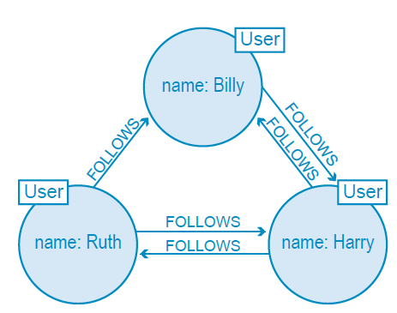
Graph Database
Twitter is a perfect example of a graph database connecting 313 million monthly active users. In the illustration to the right, we have a small slice of Twitter users represented in a graph data model.

Slide 6
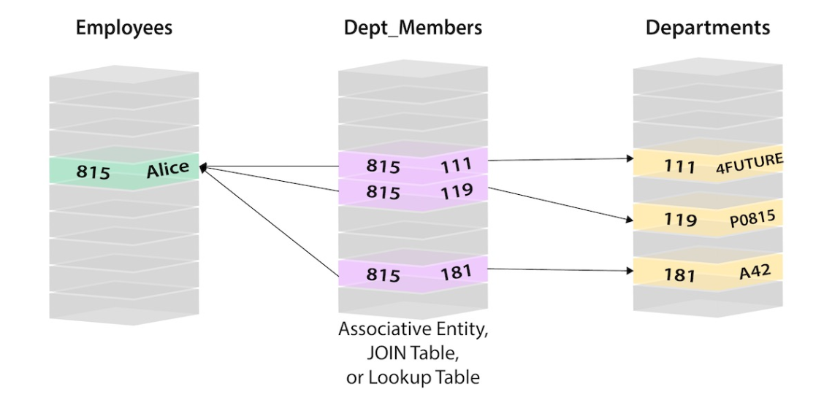
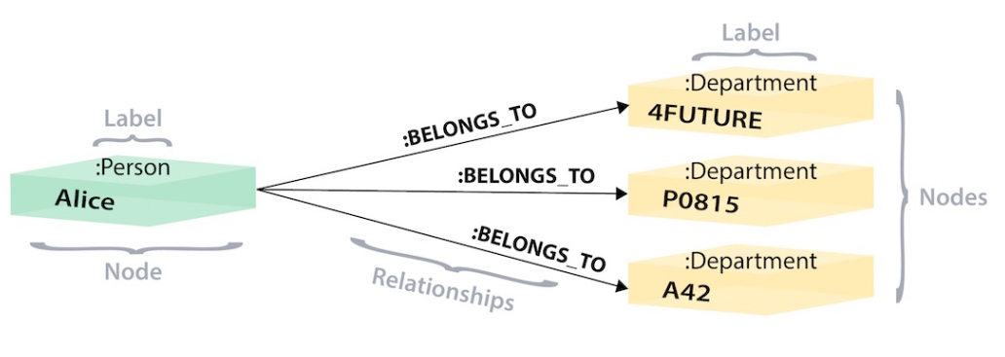
SQL vs NEO4j
SQL
NEO4j

Slide 7
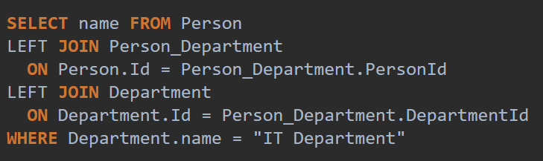
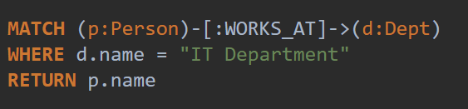
SQL vs NEO4j
SQL
NEO4j

Slide 8
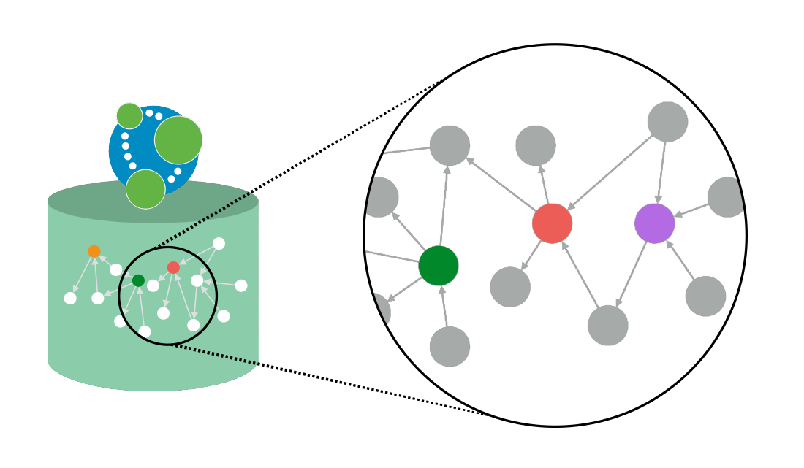
Advantages of NEO4j
Easy to Use
Visualization
Open Source
Fast
Support Network Algorism
Free Training and Certificate!

Slide 9
Neo4j Use Case
Fraud Detection
Knowledge Graph
Network and Infrastructure Monitoring
Recommendation System
Social Network Graph
AI and Analytics

Slide 10
Part 2
Neo4j Sandbox Exploration

Slide 11
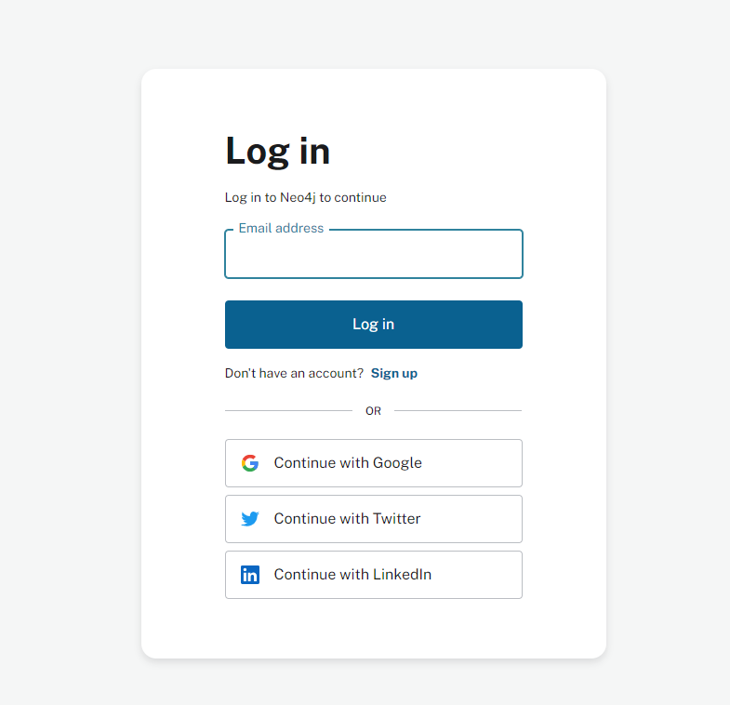
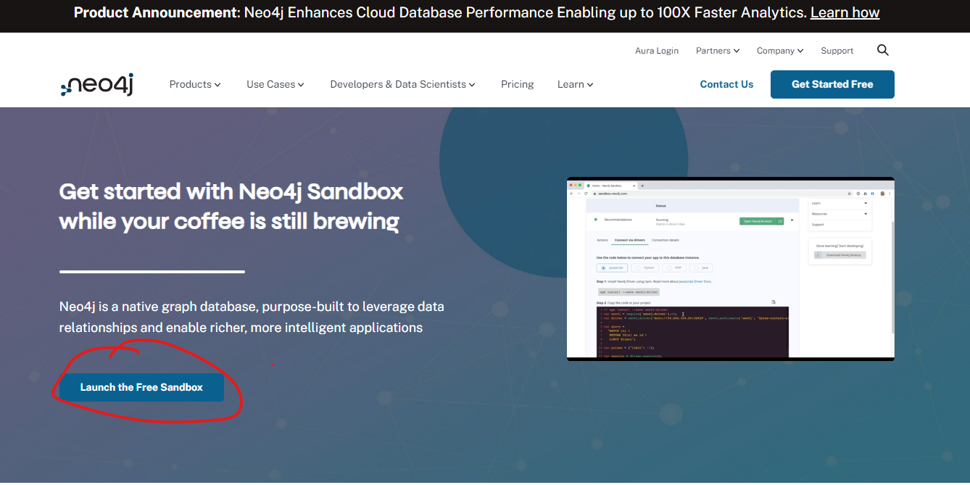
Neo4j Sandbox
Go to https://neo4j.com/sandbox/

Slide 12
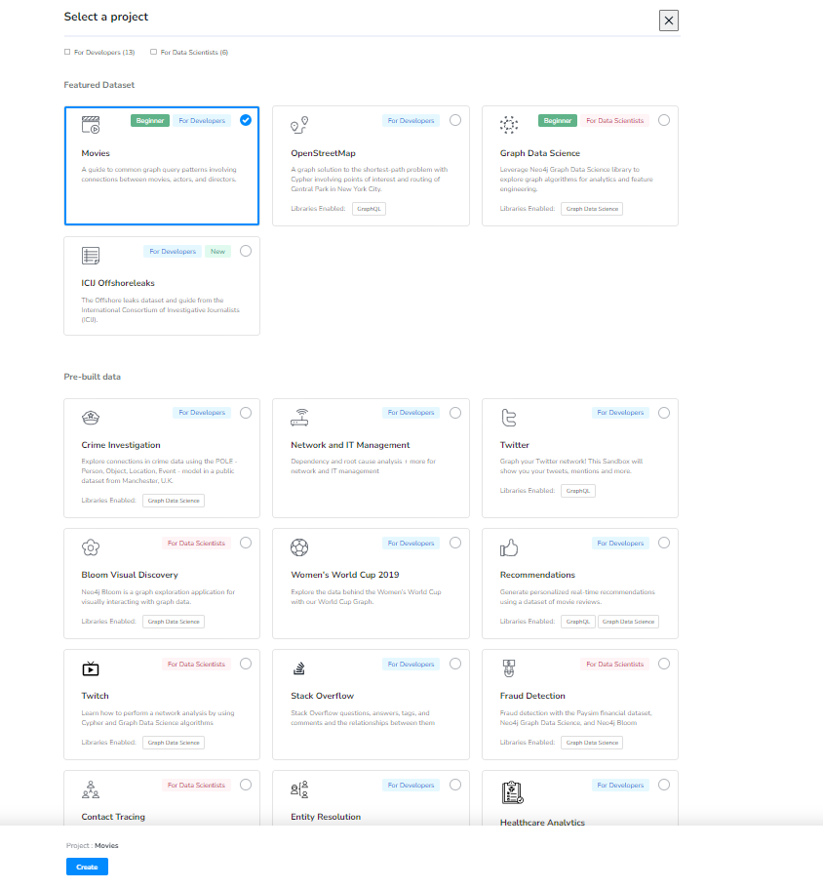
Choose a prebuild database
Choose Movies project

Slide 13
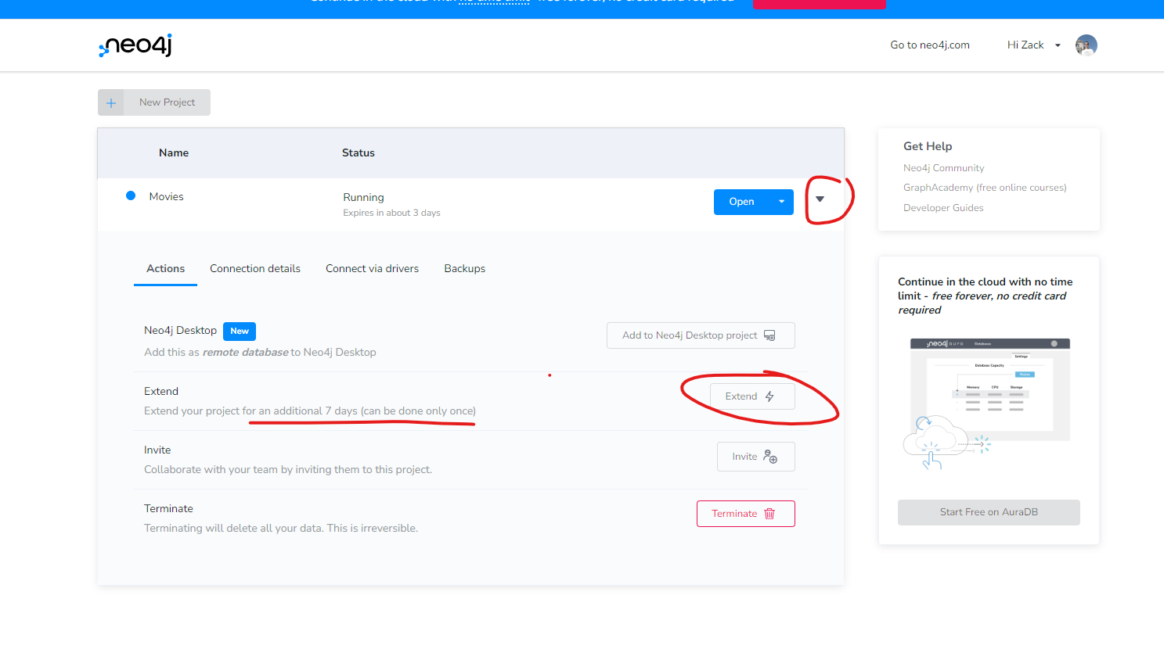
Extend your project life
By default, the project only lasts for 3 days, but you can extend it for another 7 days.

Slide 14
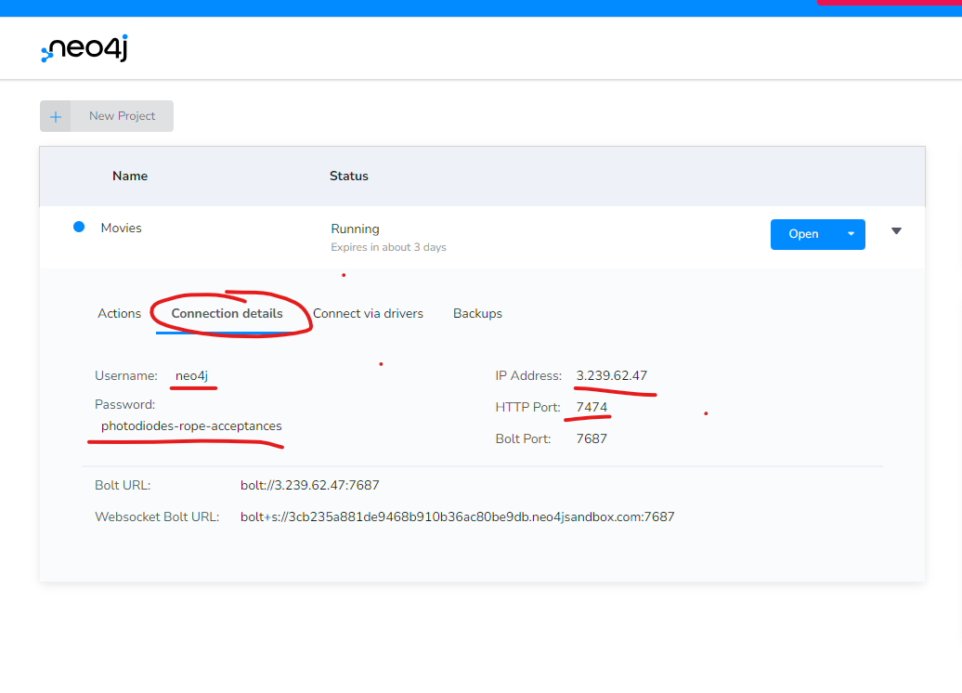
Share your database with your team
Go to Connection details
Record those infomation:
Username
Password
IP address
Http Port
Use browser to open it http://{ip address}:{port}
e.g. http://3.239.62.47:7474

Slide 15
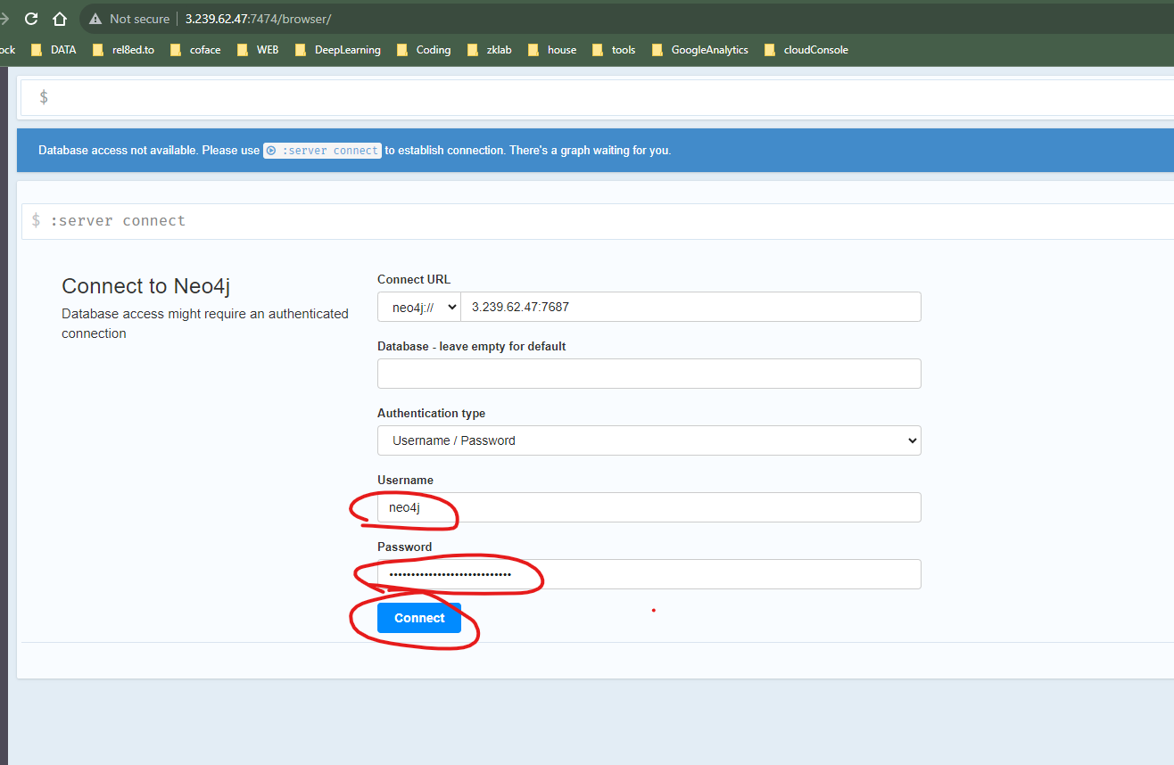
Share your database with your team CONT
Use the credential to login
You can share the credential info with your teammates to work on same project together

Slide 16
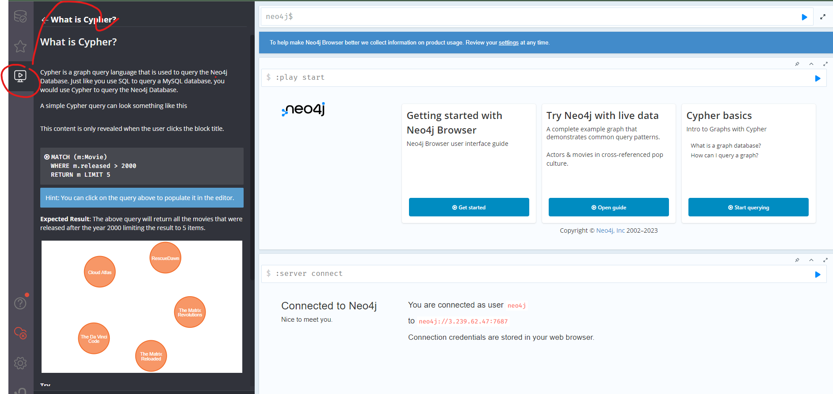
Built-in Tutorials in Sandbox
Sandboxes provide tutorials to help you understand how neo4j works
You can also view their documentation as well
https://neo4j.com/docs/cypher-manual/current

Slide 17
Practice
Q1. Show 15 person nodes
Q2. Show a table that has 12 person with their name and born attributes
Q3. Who directed movie titled “When Harry Met Sally”?
Q4. Which year did the movie with node id equal to 29 released?
Q5. How many directors in the database?
Q6. Show the names of all directors?
Q7. Create a person (use merge) named yourself, a Class node with name 5P16, link them with a relationship [:REGISTERED]

Slide 18
Part 3
Build your own

Slide 19
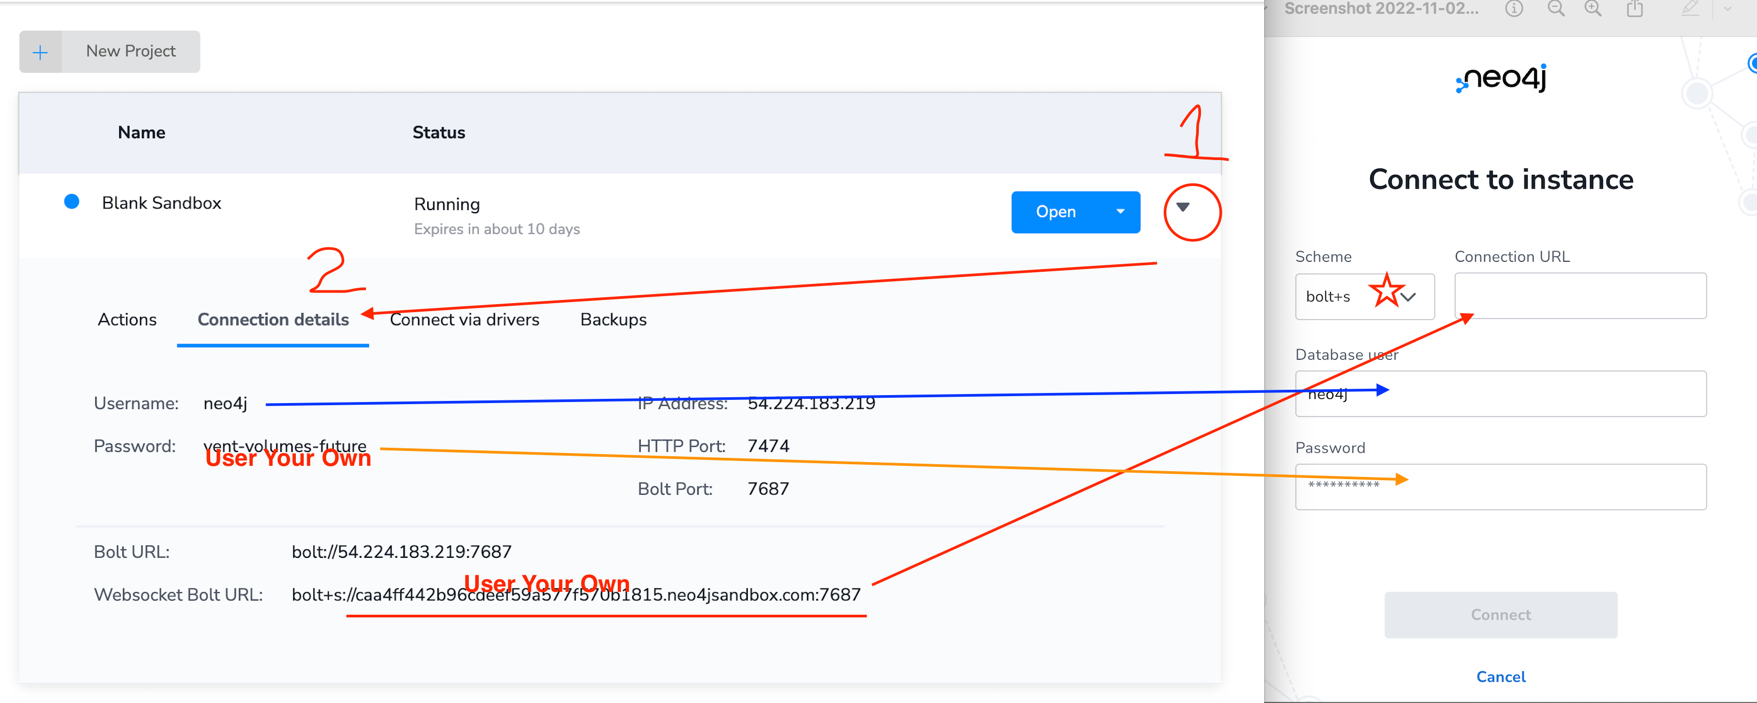
Load data with Neo4j data importer
Step 0 Create a blank database
Step 1 Download data:
https://github.com/Goodman-School/GraphDatabase/raw/main/data/W3Cnorthwind.zip
Step 2 find your db credentials
https://sandbox.neo4j.com/
Step 3 Load data
Data importer:
https://data-importer.neo4j.io/versions/latest/

Slide 20
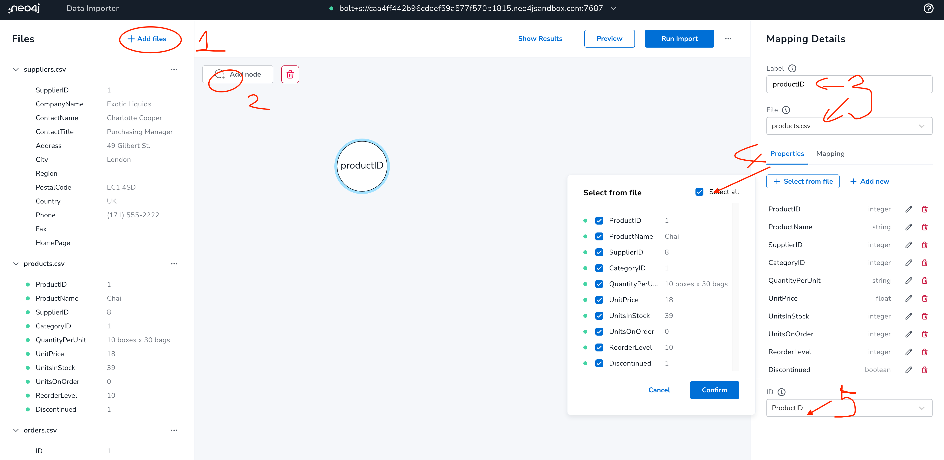
Upload files and add nodes

Slide 21
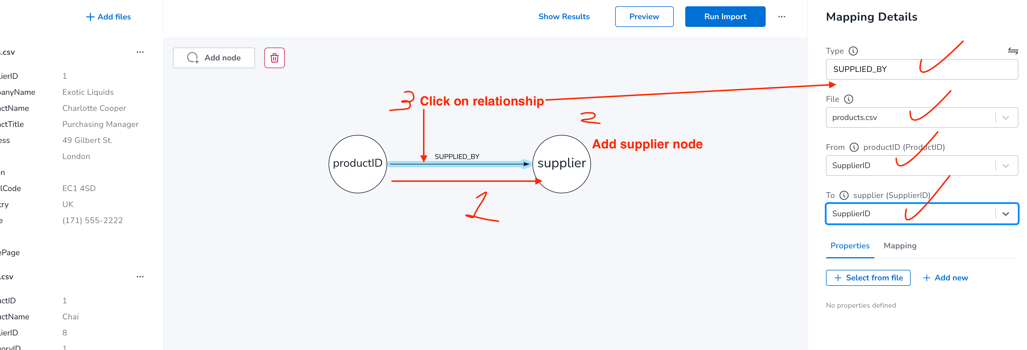
Add more nodes and relationships

Slide 22
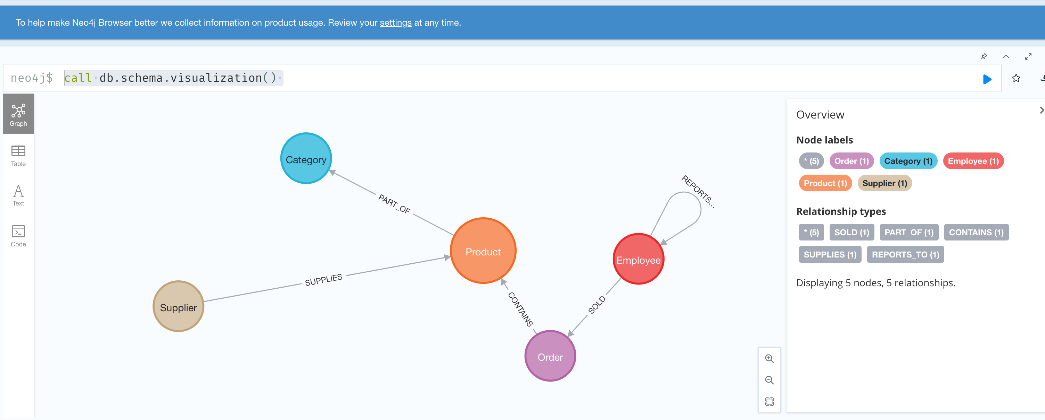
Graph Schema
call db.schema.visualization()

Slide 23
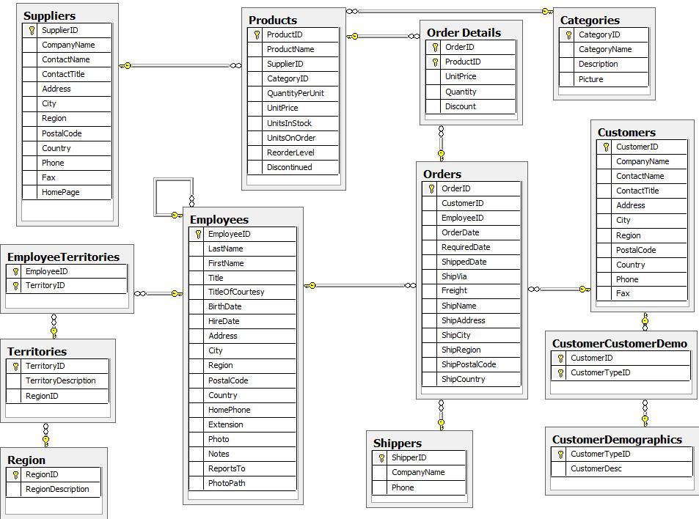
Official Tutorial (Northwind DB)
https://neo4j.com/developer/guide-importing-data-and-etl/

Slide 24
Load online data with query
Purge database:
https://github.com/Goodman-School/GraphDatabase/blob/main/queries/purgedb.cypher
Load data:
https://github.com/Goodman-School/GraphDatabase/blob/main/queries/loadnorthwind.cypher

Slide 25
Part 4
More learning resources

Slide 26
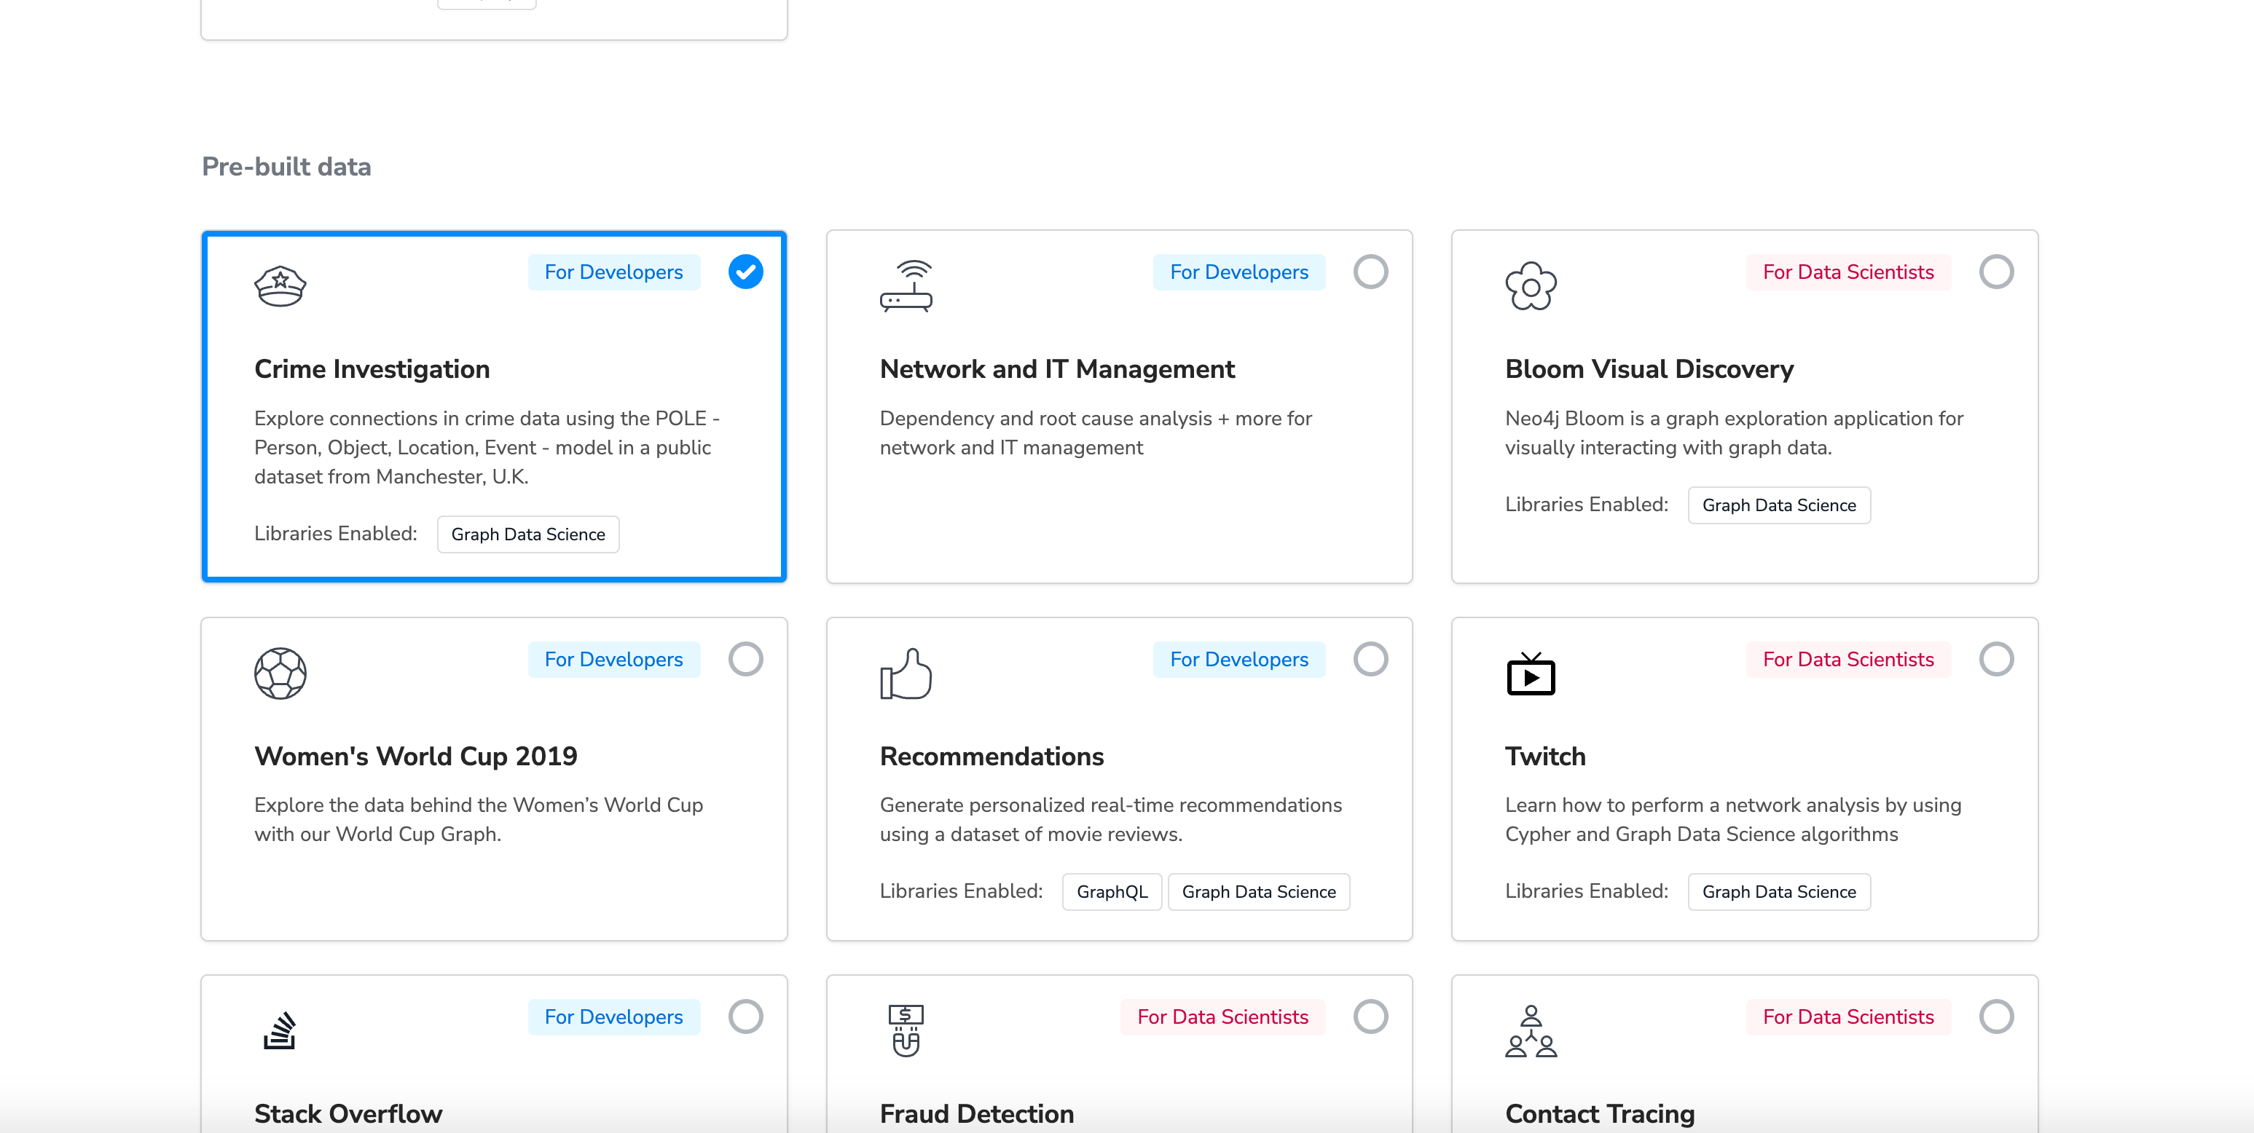
Learn more advanced technology
Follow the sanbox demo (Crime detection)

Slide 27
Appendix: Learning Resources
Download Neo4j https://neo4j.com/download/?ref=product
Use Neo4j on sanbox https://neo4j.com/sandbox/
Neo4j data importer https://data-importer.neo4j.io/versions/latest/
Free official ebooks https://neo4j.com/books/
Get Certificate https://neo4j.com/graphacademy/neo4j-certification/

